Slide 1
Security Framework for SwiftTech Solutions Ltd
Enhancing Cloud Security in Modern Work Environments
Oluwatobi

Slide 2
Contents
Introduction
Scenario Overview
Framework Scope
Risk Assessment and Threat Identification
Security Policy Objectives
Mitigation Strategies
Monitoring and Maintenance
Business Continuity
Access Control Policies
Conclusion

Slide 3
Introduction
Today, we'll explore the topic of Cloud Security in modern workplaces. In this era of digital transformation, securing cloud environments is paramount. I’ll delve into the importance of safeguarding data, infrastructure, and services in the cloud.

Slide 4
Scenario Overview
SwiftTech Solutions Ltd., a UK-based tech firm, relies on a cutting-edge cloud-based infrastructure. Their workforce, both remote and on-site, benefits from this setup. Ensuring the security of cloud resources is vital, as it underpins their operations, data, and services.

Slide 5
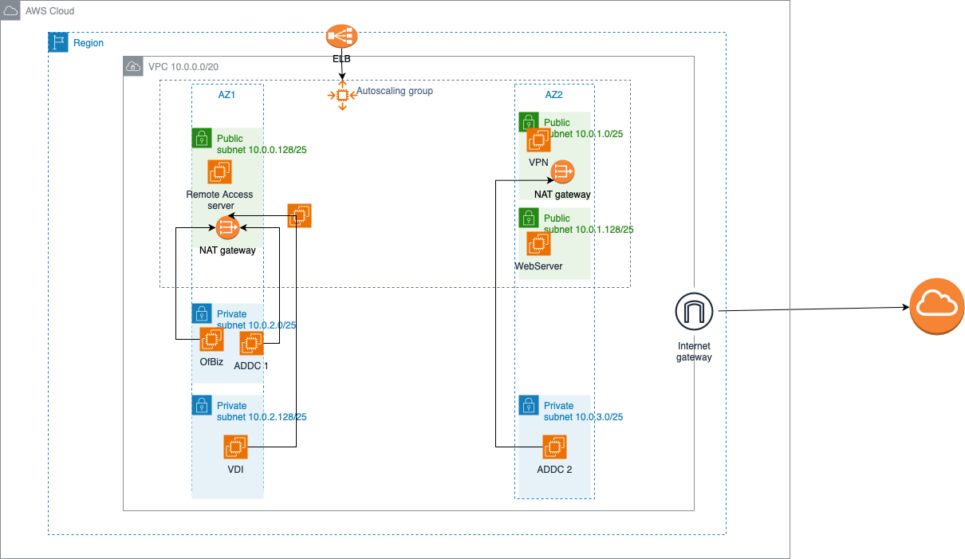
Framework Scope
The security framework encompasses a wide array of cloud assets, ensuring their protection and resilience. It covers assets such as DynamoDB, OFBiz, VPC, ADDC on EC2, and OpenVPN Access to VDI, leaving no stone unturned in securing critical components of the cloud infrastructure. This comprehensive approach is important to safeguarding our operations and data.

Slide 6
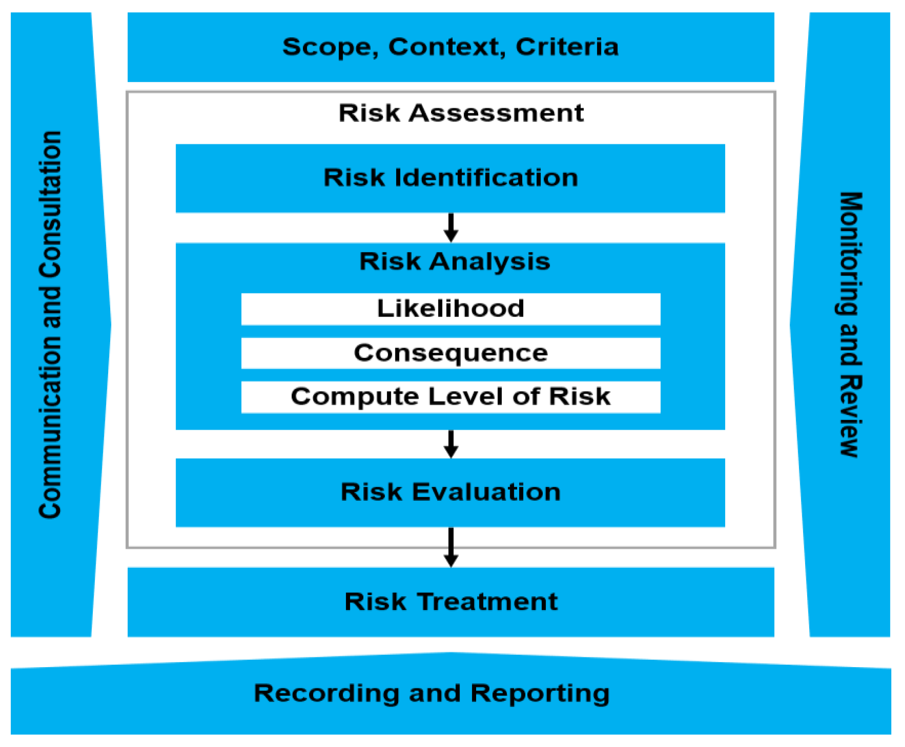
Risk Assessment and Threat Identification
Risk assessment is paramount in cloud security. We've identified specific risks for each asset in our infrastructure. This meticulous assessment is crucial to mitigating threats and ensuring the resilience of our cloud environment.

Slide 7
Security Policy Objectives
Our security policy objectives are guided by principles of confidentiality, integrity, and availability. We strive to maintain data privacy, uphold information integrity, and ensure continuous availability of services within our cloud environment. These principles are the foundation of our security framework.

Slide 8
Mitigation Strategies
For each asset, we've implemented tailored mitigation strategies to address identified threats and vulnerabilities. These actions include enhanced access controls, encryption, and redundancy measures. By proactively addressing these concerns, we fortify our cloud assets against potential risks, ensuring their security and availability.

Slide 9
Monitoring and Maintenance
Continuous monitoring and updates are essential to our security framework. We maintain vigilance through regular assessments, audits, and updates, ensuring our cloud security measures remain effective and adaptive.

Slide 10
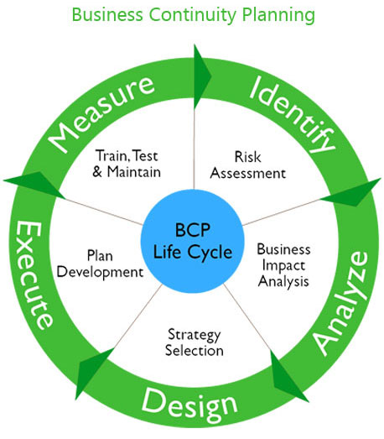
Business Continuity
Business continuity and disaster recovery plans are fundamental. They ensure our operations can persist through disruptions, safeguarding our services and data in the cloud environment.

Slide 11
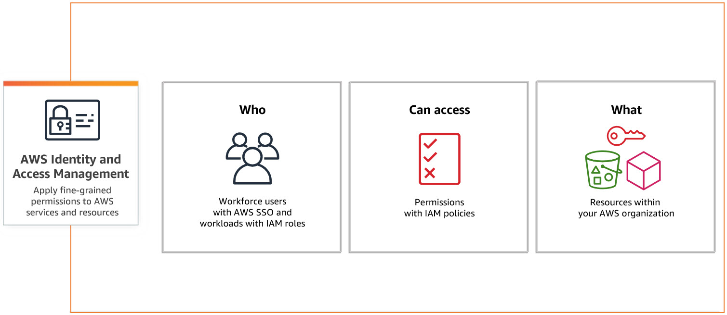
Access Control Policies
Our access control policies dictate stringent restrictions and robust authentication methods. They ensure that only authorized individuals gain access to our cloud assets, enhancing security and data protection.

Slide 12
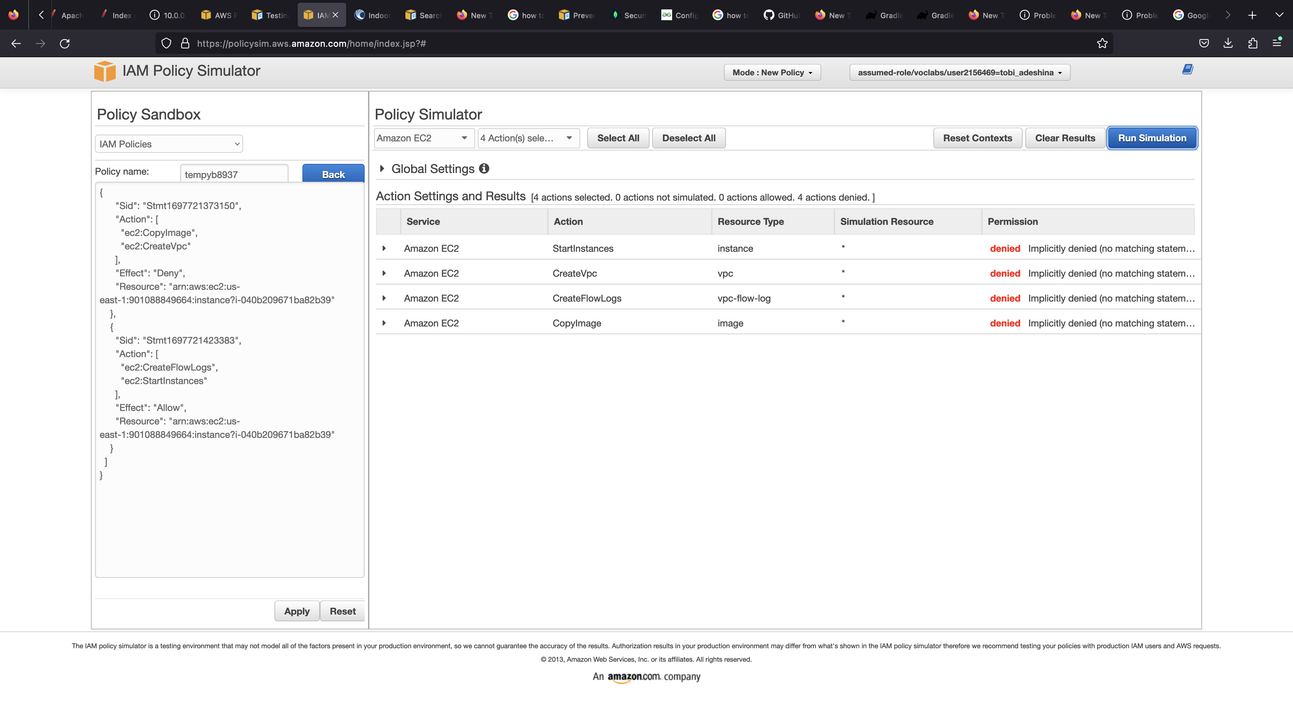

Slide 13
Conclusion
In conclusion, securing our cloud environment is paramount. It underpins our operations, protecting data and services, and ensuring resilience.

